Slide 1




COUNTERING
DWINDLING
ENROLLMENT
TACTICS FOR SCHOOL GROWTH (AKA SURVIVAL)
PRESENTED BY:

Slide 2
Agenda
  Introductions
  Engagement/Questions – CB/NCB, facility over/undersized
  Enrollment landscape
  Strategies for retaining who’s there now
  Strategies or gaining who isn’t there yet
  Summary / conclusion
  Call to action

Slide 3
Who is joining us in the room?

Slide 4
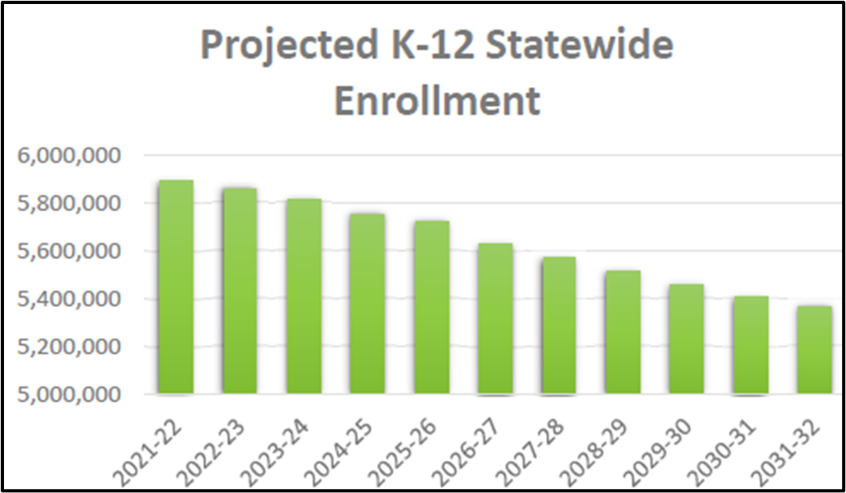
California’s Declining Enrollment
Down 310,000 students since 2019
No large positive signs in 2023
    40,000 more students exit
K-12 enrollment projected to decrease
    Tk, K, 1st hit hardest
Sources: California State Department of Finance
Public Policy Institute of California

Slide 5
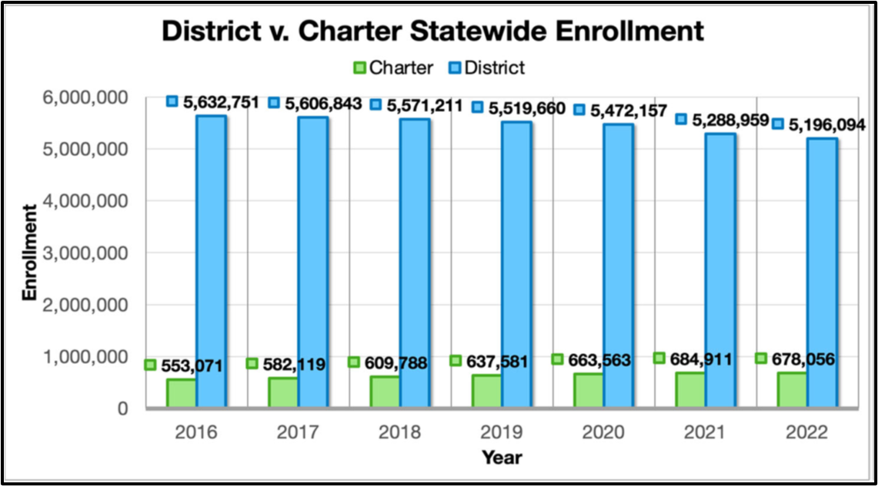
California’s Declining Enrollment
Public Education is down overall
  Districts are losing students
  Charters are gaining students
Private schools are up overall

Slide 6






Retention Strategies
Accurate Budgets
One-time Funding
Difficult Decisions
Revisioning

Slide 7


How do we budget for this?
Pre-pandemic vs. post-pandemic
01
ENROLLMENT TRENDS
  At your school
  In your district / community
Fund balance (positive & trending up?)
02
FUND BALANCE
  How much is driven by unused one-time funds?
  How much is due to financial management?
5-YEAR OUTLOOK
5-year Financial Outlook
03
  Surpluses annually or deficits
  Enrollment decreasing/flat/increasing
  What happens when one-time monies go away?

Slide 8
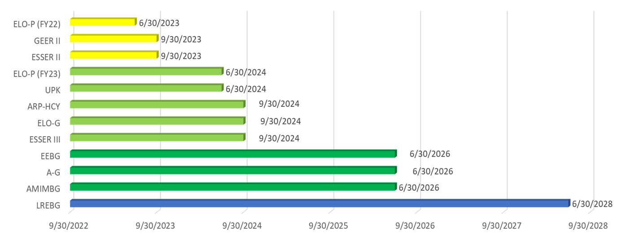
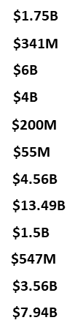
One-Time Grants
$55 Billion

Slide 9

Difficult Decisions to be Considered
Are you under or over-staffed?
01
STAFFING
  Pupil-Teacher ratios
  Administrative staff
  Overlapping or redundant positions
Large projects revised or postponed
02
PROJECTS
  Facilities projects
  TI’s, athletic courts etc.
  Major equipment or software purchases
Other
03
OTHER
  Combined classrooms
  Grade-levels; is one area outpacing another (K-5 v 6-8)

Slide 10

Revisioning and Recommitment
Staff aligned with enrollment & programs
01
STAFFING
  Are we ready to make difficult decisions?
  Do changes put us on a firmer financial footing?
  Do changes improve educational outcomes?
Capital projects & major expenditures
02
PROJECTS & EXPENDITURES
  Do the resources exist for these projects?
  Do I have the funds to maintain the project or expenditure after the one-time funds run out?
Other
03
OTHER
  If it becomes necessary to combine classrooms, how long can this continue without impairing the students and teachers?
  What am I doing to counteract lowering enrollments around me?

Slide 11







Strategies for gaining new students
Ground level
Alignment to Community
Better Option
Differentiate
Story Telling

Slide 12
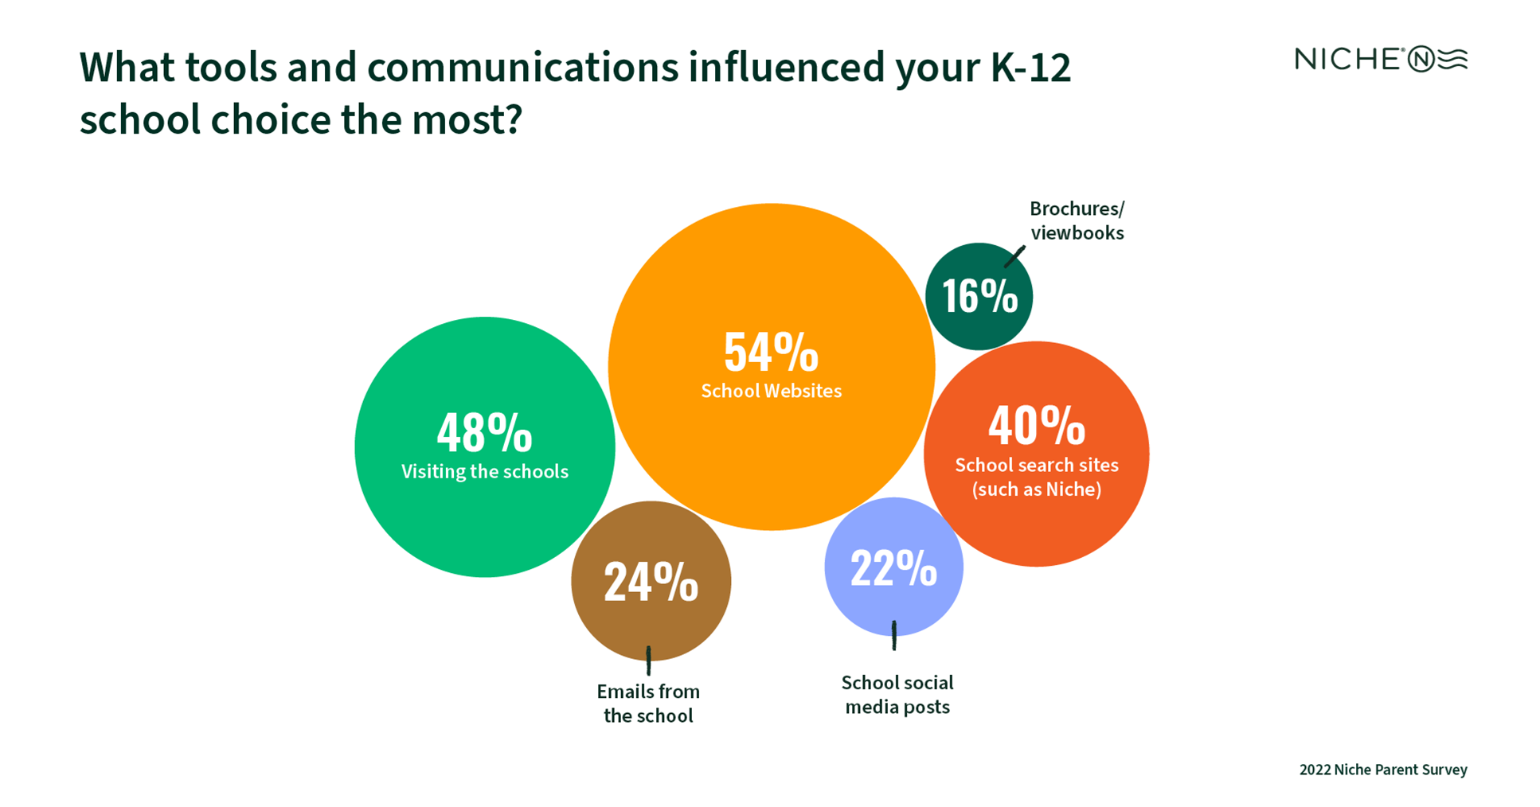
Tools that influenced school choice most

Slide 13

Ground-level tactics
Internally
1. Have I empowered my Enrollment Team to do what they need to do?
    Goals and Objectives of the Team?
    Developing Proper planning for both Fall and Spring Enrollment
2. Have I made sure the proper environment exists for these new students and is the entire school team ready for the new students?
3. Does the community see my school as a safe place and where they would enroll their child?
Externally
1. How is my school being perceived from the outside?
    Is this perception realistic?
    Do I need to change that reality?
2. Have I considered using a Marketing firm to improve the perception of my school?

Slide 14

Pairing with Community Needs
What is the Overarching Goal:
Needs to be a direct correlation between your community and your school.
What values does your community have?
What are parents looking for in a school?
  Finding out from your community what they want to see in a school?
  Do you have programs that distinguish your school from others?
  Can you strategically appeal to your community as to the importance of your school?
  Pairing the programs in your school with the needs of the community and the parents.
  A proper LCAP can assist in this match, but if the parents don’t know what’s in the LCAP…?

Slide 15
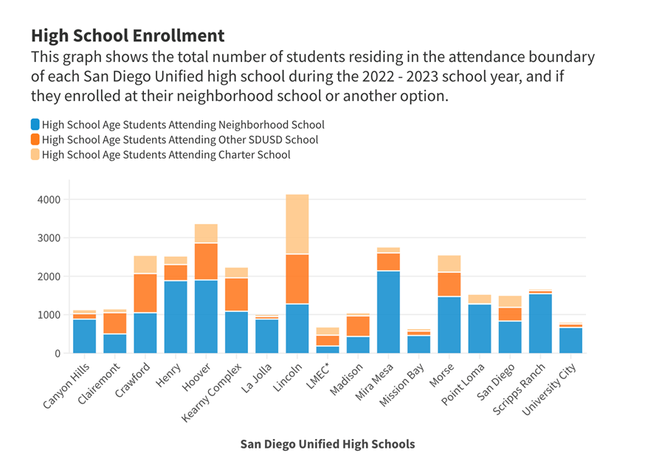

How to show your the better option

Slide 16

Stand Out in the Crowd
Differentiating yourself in an oversaturated market
CA: 1,336 Charters serving 692,783 Students

Slide 17
Understand Your Unique Value
  Identify and leverage your school’s distinct strengths and offerings
  Showcase Successes - Highlight the achievements and outcomes of your students and staff, collect success stories whenever possible!

Slide 18
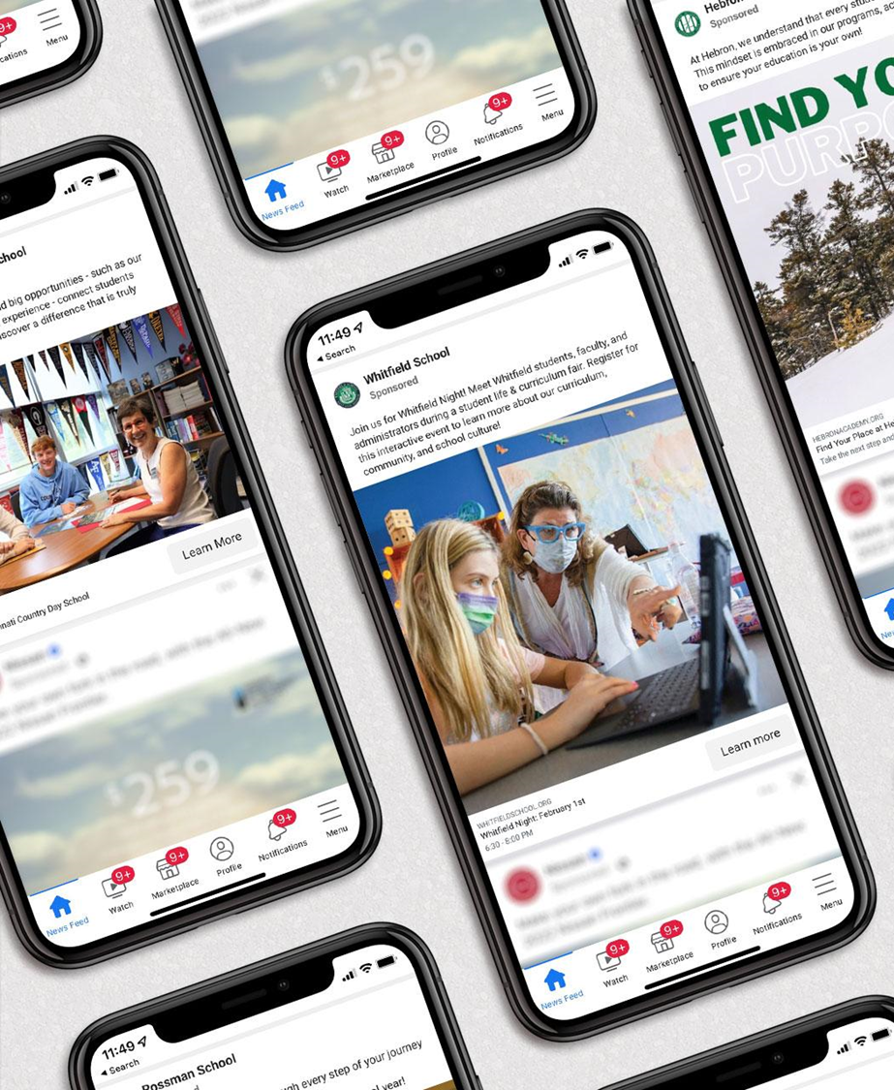
Digital Marketing
  In a crowded space, part of the challenge is being seen. Use digital marketing to ensure the right audiences know your school exists.
  Engage the Community - Social Ads can help build credibility and establish your school as a community pillar.

Slide 19

The Power of Your Website
Telling Your School’s Story So It Resonates
According to the 2022 Niche Parent Survey, 54% of Parents said School Websites were the most influential engagement channel influencing their final enrollment decision.

Slide 20
Visual Storytelling
  High Quality Photos & Video
  Why You Are Different
  Testimonials
  Differentiators and Fast Facts
  News & Events
  Call to Actions

Slide 21

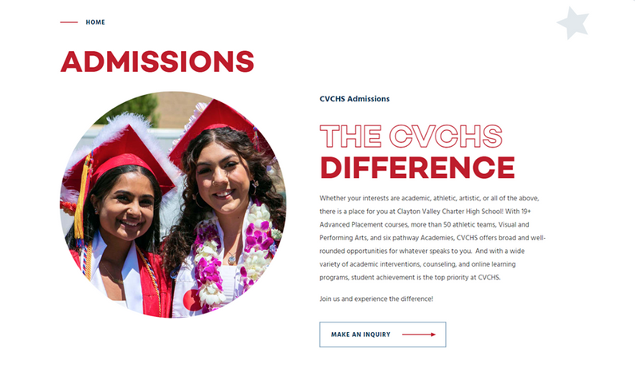
More than Just the Homepage
Why Landing Pages Matter
Conversions happen on landing pages, not the homepage.
Your Landing Page Checklist:
  A Clear Value Proposition
  What to Expect
  Compelling Visuals
    *Video can increase conversions by as much as 80%
  Strong call-to-action
  Differentiators
  Short and Inviting Forms
  More Testimonials
  Upcoming Events & Information Sessions

Slide 22

Digital Communications
Engagement Along the Path to Enrollment

Slide 23
Summary
  California is facing an enrollment drop of approximately 8%-10% over the next 10 years.
  Even though there are slightly higher annual COLA numbers over that period, the COLA increases in revenue will not match the COLA increases in expenses, when taking into consideration lowering enrollment.
  There will be far fewer one-time funds allocable to schools over the next several years as the State continues to maintain deficits in their budget.
  Schools will be competing against one another for students in their community, and schools must be prepared to show their advantages over others.

Slide 24
Call to Action
  Schools all over California are facing a time where parents have greater choice to send their kids to the schools THEY are choosing for their child.
  Now is the time, when many schools received cash infusions of one-time funds to make the needed changes in programs to differentiate themselves from other schools in the community.
  Schools that do not adapt to the changing paradigm of lower enrollment over the next decade, may see their schools depopulated, which will result in staffing losses, program elimination, and some very hard decisions that need to be faced. Those that adapt will see improved enrollment, additional funds, and a better school environment in which to operate.
  NOW is the time to act!! Let’s do this!!

Slide 25

THANK YOU!
ANY QUESTIONS?
Jim Surmeian
jsurmeian@charterimpact.com
Philip Goulet
philip.goulet@finalsite.com
Andrew Crowe
Deputy Director
Kate Eng
keng@charterimpact.com

